Slide 1
Judaism and Christianity

Slide 2
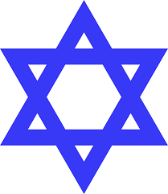
Judaism
What does it mean to be Jewish?
Ethnicity – Descended from Jews (Family descent and cultural identification)
Conversion to Judaism (in practice only)
Hebrews = Jews

Slide 3
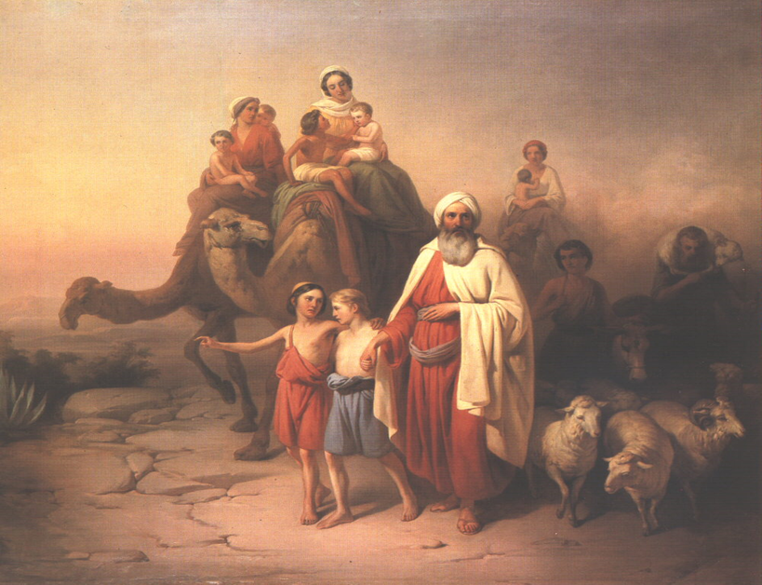
Abraham
1800 BCE: The Jews emerged as a distinct culture.
According to Judaism, Jewish culture begins with the family of Abraham
Characteristics of civilization diffused from the Egyptians, Sumerians, and Phoenicians.
They conquered the Canaanites.

Slide 4
Monotheism
The Jews rejected polytheism.
They believed in They believed in one omniscient, omnipresent, omnipotent, uncreated creator.
They believed that God had promised them a special land and relationship if they kept His law.

Slide 5
The Covenant
“Now the LORD had said unto Abram, Get thee out of thy country, and from thy kindred, and from thy father's house, unto a land that I will shew thee. And I will make of thee a great nation, and I will bless thee, and make thy name great; and thou shalt be a blessing.”
“On that day, God made a covenant with Abram, saying: "To your descendants I have given this land, from the river of Egypt as far as the great river the Euphrates.”(Genesis 15:18)
"And I will give to you and to your descendants after you, the land of your temporary residence, all the land of Canaan as an eternal possession and I will be a God to them." (Genesis 17:8)

Slide 6
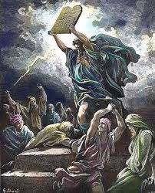
The Tanakh
Hebrew script developed from Phoenician around 1000 BC.
The Hebrew scriptures are called the Tanakh
The Torah [תורה] are the first five books of the scriptures and were written by Moses.
The Torah contains the Law of Moses (including The Ten Commandments)
It also contains the story of creation and beginning of the Jewish nation.

Slide 7
The Tanakh
The other scriptures include: Nevi’im [נביאים] meaning "Prophets" Ketuvim [כתובים] meaning "Writings“
Tanakh is an acronym for these books.
Ta= Torah
Na=Nevi’im
Kh=Ketuvim
Later, the Talmud, a series of authoritative interpretations of the Tanakh, emerged.

Slide 8
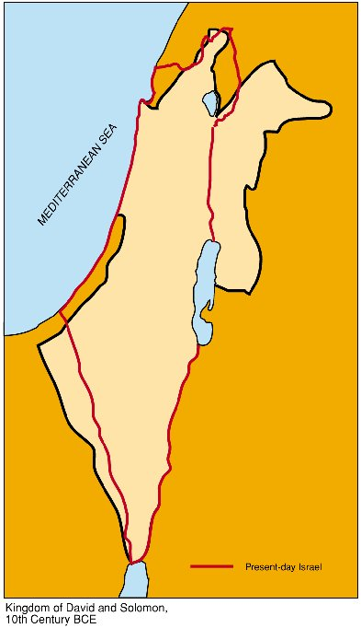
Jewish Kingdoms
The first rulers were High Priests (Priest-Kings) with scribes as important positions.
Later High Priests became politically less powerful than Kings.
The original three kings of Israel were Saul, David, and Solomon.
After three kings the Kingdom was divided between Israel in the north and Judea in the south.

Slide 9
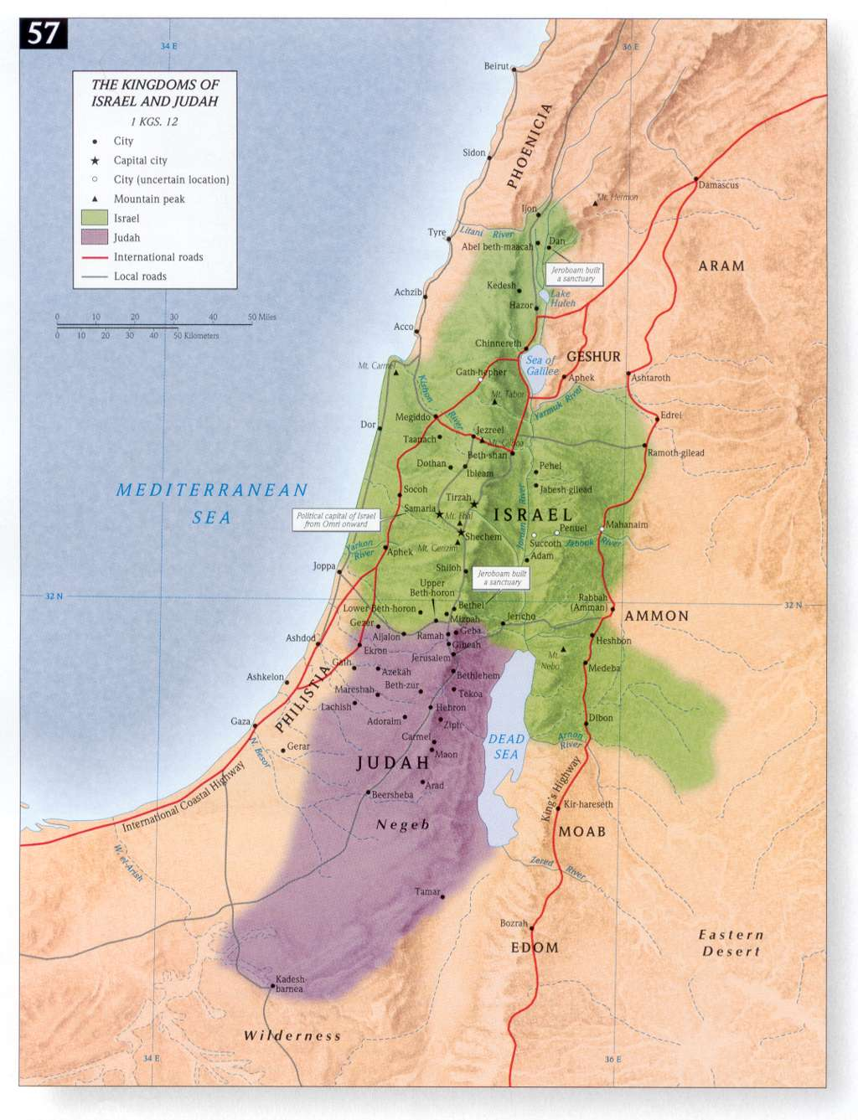

Slide 10
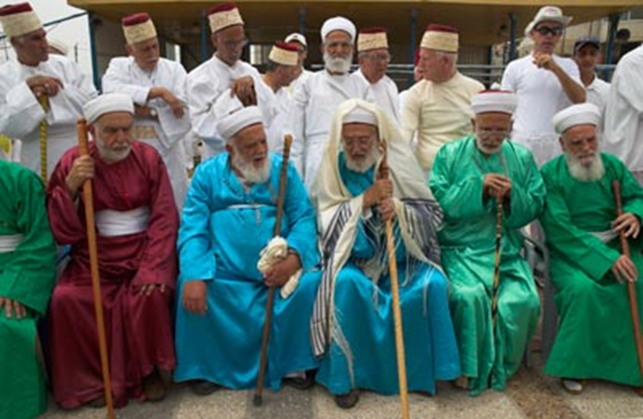
Samaritans
The northern Kingdom of Israel was destroyed by the Assyrians in 720 BCE.
The Samaritans claim descendency from the survivors (there are only about 700 remaining survivors today.)

Slide 11
Judaism
Often conquered by other more powerful civilizations, the kingdom of Judah lasted until 70 CE.
In 70 CE the Romans destroyed the kingdoms for good after the Jewish-Roman Wars.

Slide 12
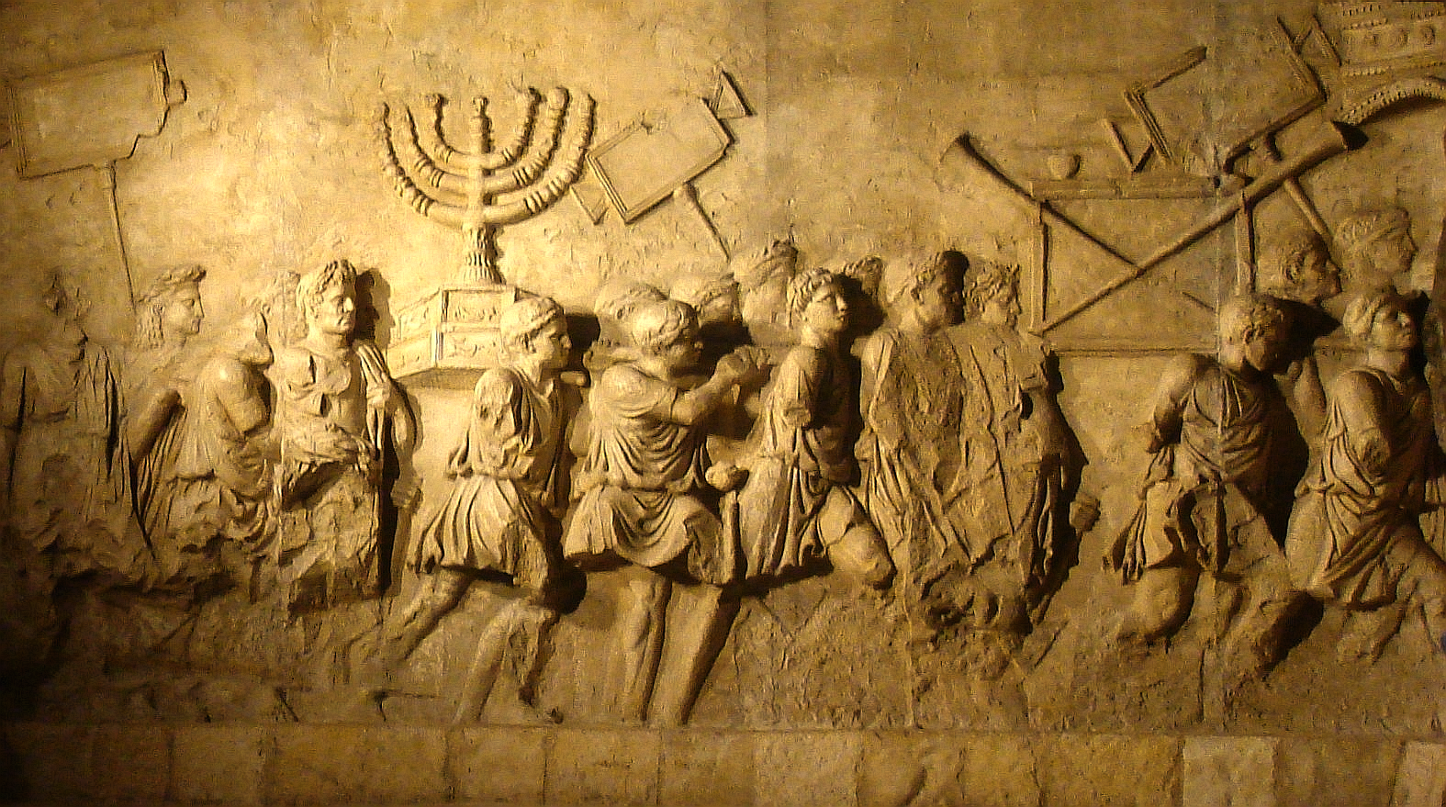
Jewish-Roman Wars

Slide 13
Diaspora
The Jews were dispersed throughout the Roman empire, living as small communities and trying to keep their culture.
Diaspora: The dispersion of a culture throughout the world.
They began to marry into and speak the languages of the culture around them, while maintaining a separate culture.
Today there are Jews of every race speaking many languages.

Slide 14
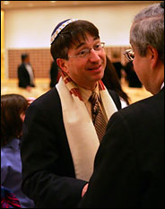
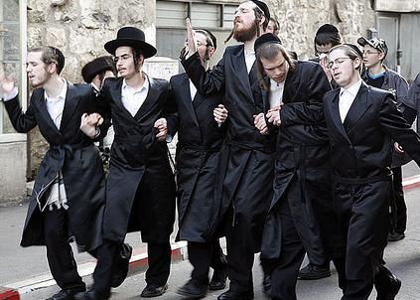
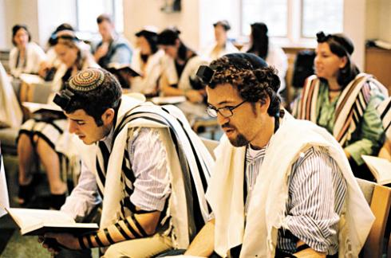
Sects of Judaism
Three modern sects (branches) of Judaism:
Reform
Conservative
Orthodox

Slide 15
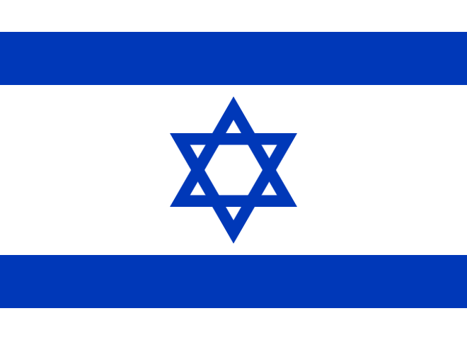
Zionism
Late 1800s: Zionism - European Jewish leaders call for the creation of a Jewish nation-state.

Slide 16
Christianity

Slide 17
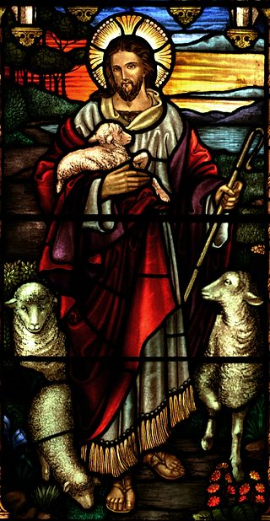
Origins
30 CE: A Jewish sect formed around the teachings of Jesus of Nazareth
Those who followed Jesus believed that he was the Messiah.
Messiah – the deliverer or savior of the Jewish people
The Jews believed that the prophets had foretold of a person who would deliver them from foreign domination and bring back the original kingdom of Israel.
Christ is the Greek word for Messiah.

Slide 18
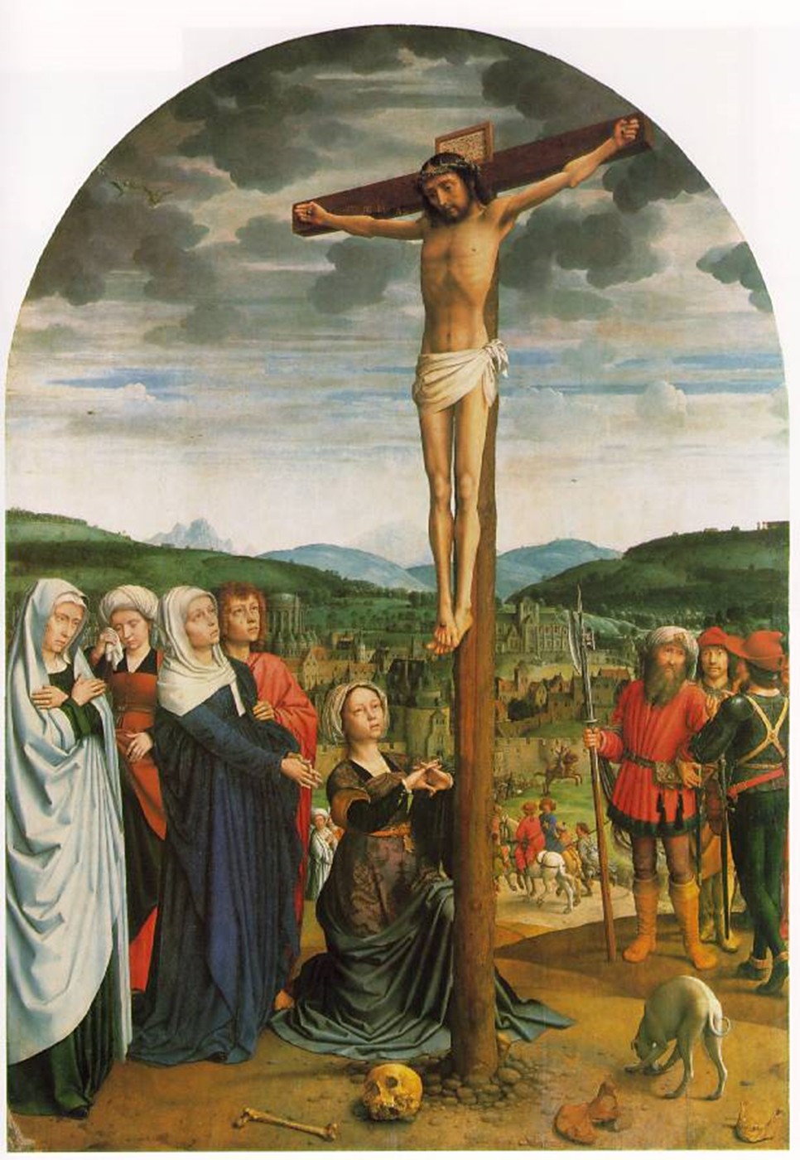
Crucifixion
Christians came to believe that the Christ was also God’s son.
The Romans began to refer to the followers of Jesus as Christians.
Jesus was executed by the Romans for leading a rebellion against their rule.
His death by crucifixion became a major symbol of the Christian faith.

Slide 19
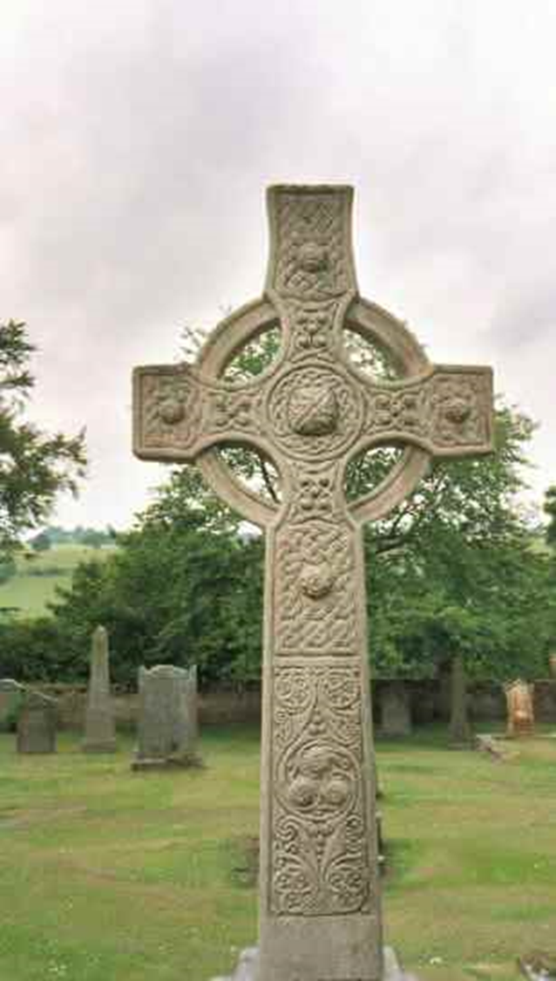
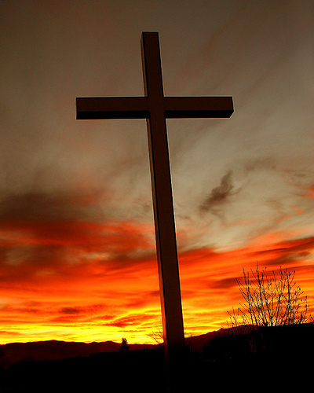
The Cross
The cross became the most important symbol of Christianity.

Slide 20
The Resurrection
Jesus’ followers believed that he was brought back to life by God and taken to heaven.
They believe that he will one day return.
Christians believe in the Trinity: The Father, Son, and Holy Spirit are one god.

Slide 21
Teachings of Christ
Christians kept the Jewish scriptures/law and added the “sayings of Jesus.”
During the first centuries church leaders wrote letters of instruction and the Gospels.
Gospel: an account of the life of Jesus

Slide 22
The Bible
By the 5th century the Bible was established.
This produced the Old Testament and the New Testament.
Testament - a covenant between God and the human race.

Slide 23
Rome and Christianity
At first Christians were outlawed by the Romans as a cult and rebellion.
325 CE: The Council of Nicea was called by Constantine to unify Christianity.
By the 5th Century, Christianity had become the official state religion of Rome.

Slide 24
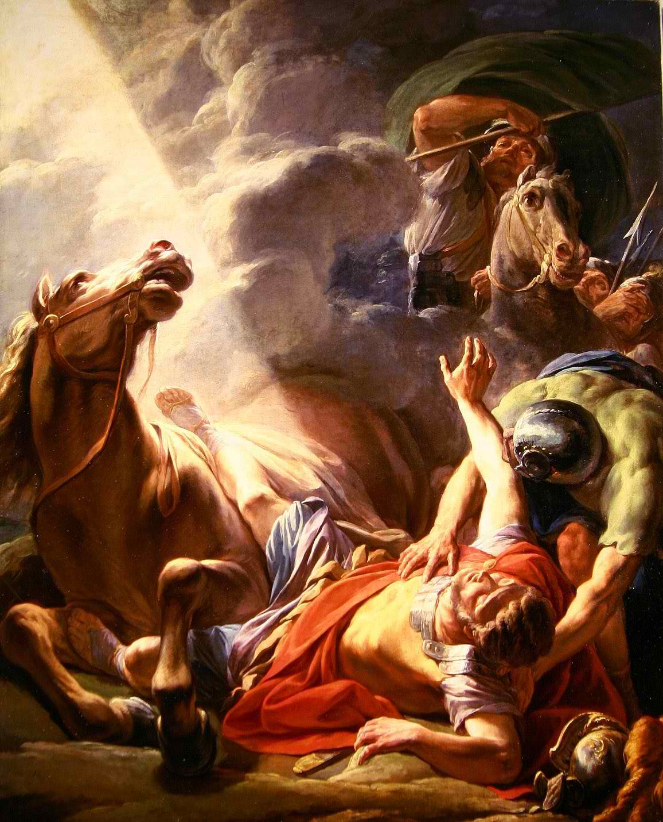
Missionary Activities
Unlike Judaism, Christianity produced missionaries.
Christians believed they were called upon by God to convert the gentiles, or non-Jews, to their faith.
This caused the diffusion of Christianity around the world.
Saul, originally a persecutor of Christians, converted after an encounter with God and became Paul.
He then became a key figure in the spread of Christianity throughout the Roman world.

Slide 25
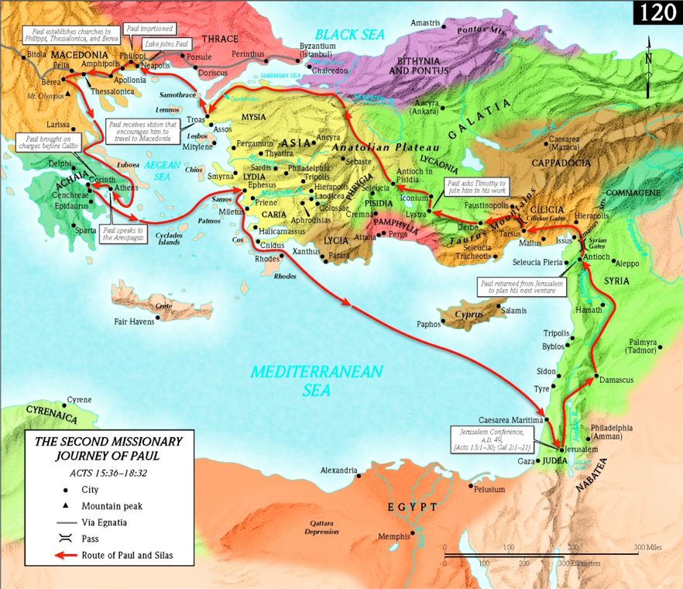

Slide 26
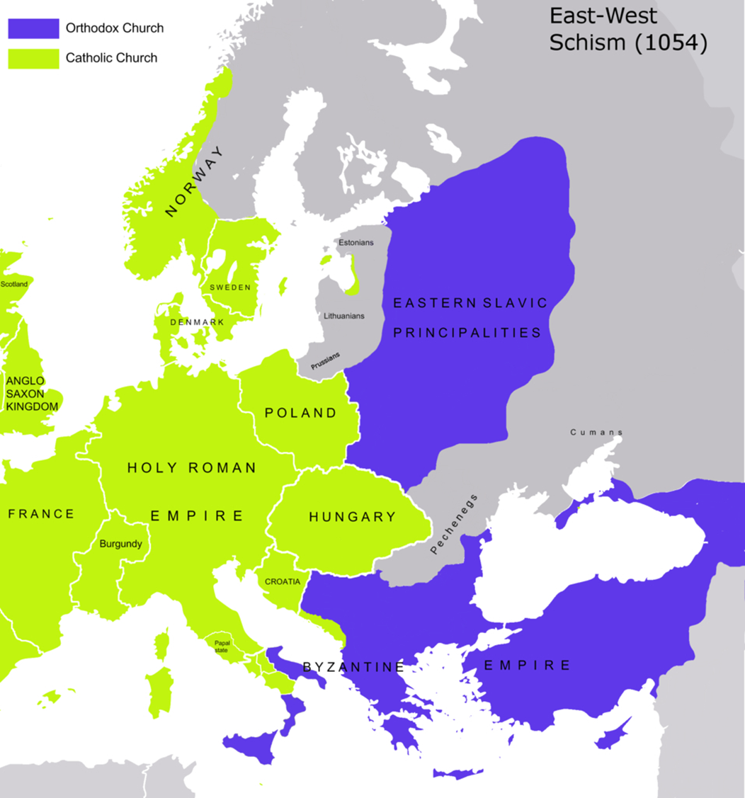
The Great Schism
1054 CE: The Great Schism occurred
The split the Christian church between Catholicism and Orthodox faiths.

Slide 27
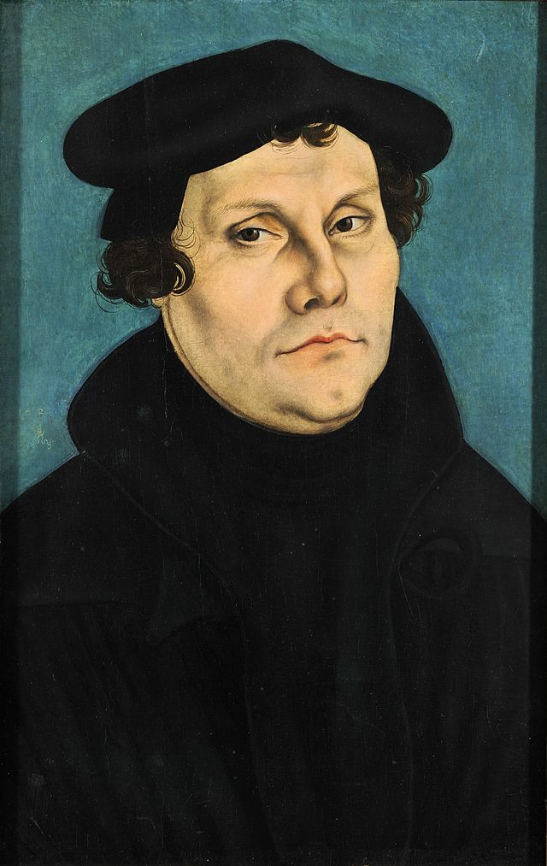
The Protestant Reformation
Fueled by church corruption, a Catholic monk named Martin Luther sparked the Protestant Reformation.
Other European powers which were dissatisfied with the power of the Church led their own rebellion further splitting the Church.
This rebellion created a new branch of Christianity called Protestantism.

Slide 28
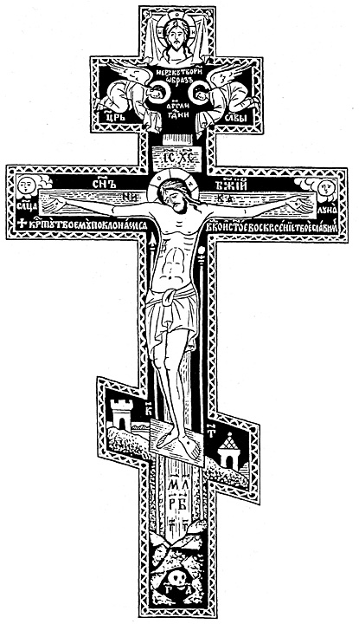
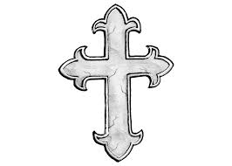
Sects of Christianity
Three main branches of Christianity:
Eastern Orthodox
Roman Catholic
Protestant

Slide 29
Three main branches of Christianity: 1. Eastern Orthodox, 2. Roman Catholic 3. Protestant

